Slide 1
Reducing the European deficit of Platinum Group Metals (PGMs), by upscaling to industrial relevant levels a novel cost-efficient and miniaturised PGMs recovery and raw material production process
Platirus Project - General presentation

Slide 2
Outline
The Platinum Group Metals (PGMs)
Supply, demand and use of Platinum-Foresight for the coming years
Importance of Platinum for the EU economy
The Platirus project : Its aim, activities and expected benefits

Slide 3
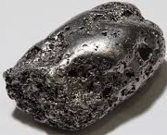
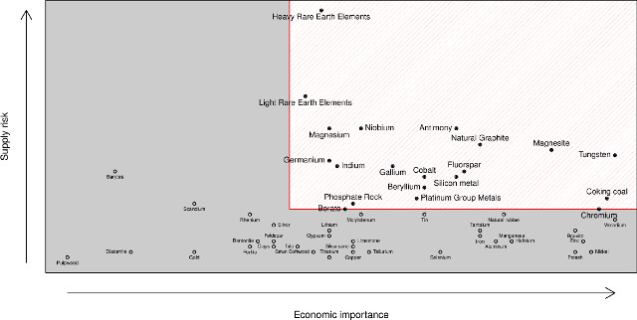
The Platinum Group Metals (PGMs)
PGMs comprise 6 chemically very similar elements: ruthenium (Ru), rhodium (Rh), palladium (Pd), iridium (Ir), osmium (Os) and platinum (Pt);
PGMs are among the least abundant of the Earth's elements and are classified by the EC as critical raw materials (CRMs);
Platinum is the most commercially important of all the PGMs, having the largest range of applications.

Slide 4
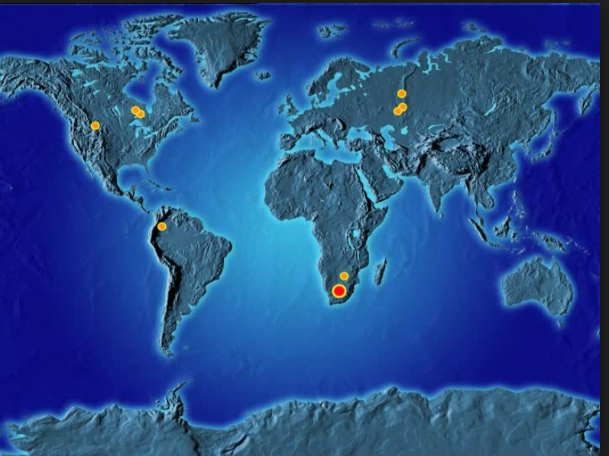
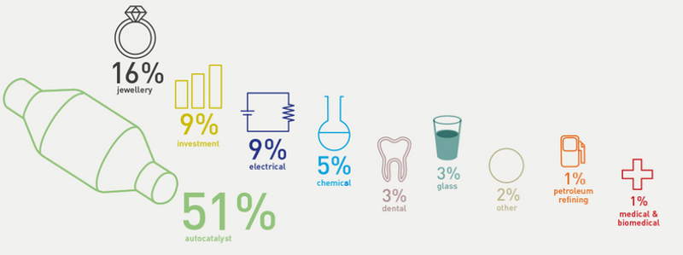
Supply, demand and use of PGM- e.g. case of Platinum
Platinum market remained in deficit in 2016 despite a significant deterioration in platinum purchasing by Chinese jewellery fabricators
Zimbabwe
North America
Rest of the world (Source: Framepool)
PGM usages per industry as in 2010
Source: IPA
Source: JM’s report November 2016
Source: JM’s report November 2016
(1moz=28 tonnes)

Slide 5
Forecast Platinum supply and demand Source: Johnson Matthey, Glaux Metal , January 2016
(1moz=28 tonnes)
Primary Supply is not forecasted to increase
Supply from recycling is forecasted to increase
Demand is increasing
Deficit is forecasted for the coming years

Slide 6
Supply, demand and use of PGMs- e.g. case of Palladium
Similarly- Palladium market remained in deficit in 2016
Source: JM’s report November 2016
(1moz=28 tonnes)
Source: JM’s report November 2016

Slide 7
Importance of PGMs for the EU economy
In 2013 more than 21% of the global demand of Platinum was related to the European market (~50 tonnes-worth more than €1 Billion). Europe is the first consumer of Platinum in industrial products.
Auto catalyst application was estimated to use 41% of EU PGMs in 2014. EU is the highest consumer of platinum and an important consumer of palladium and rhodium for autocatalysts.
Source: JM report November 2016
Source: JM report November 2016
Source: JM report November 2016

Slide 8
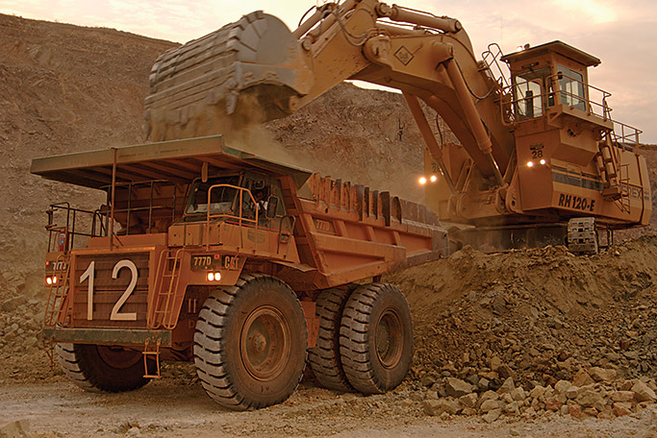
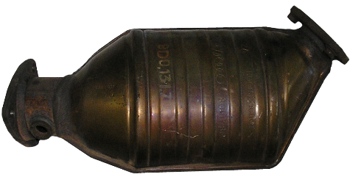
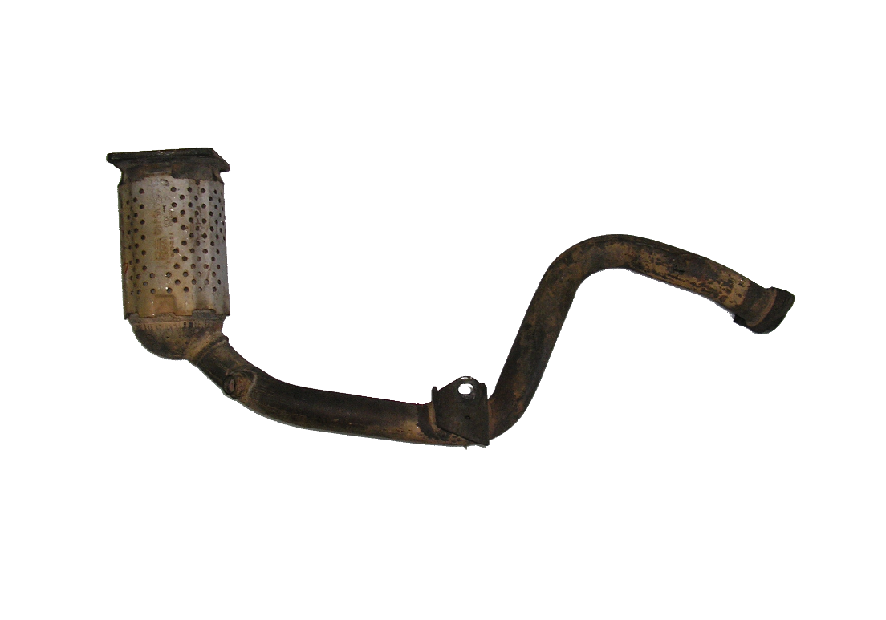
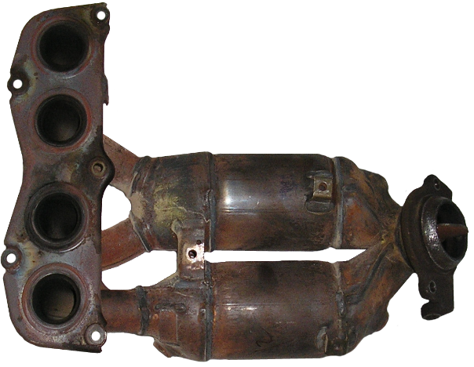
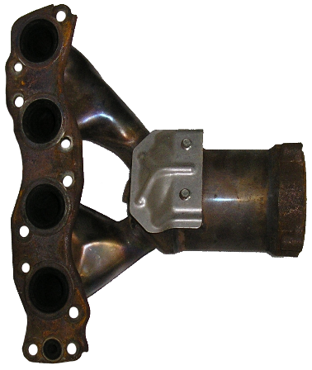
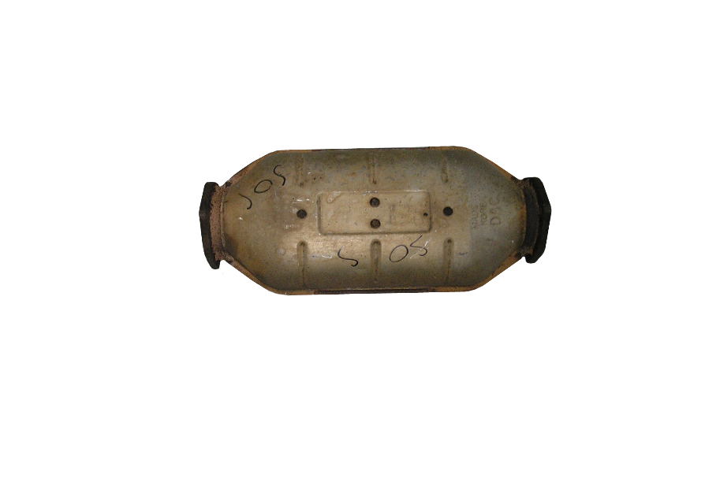
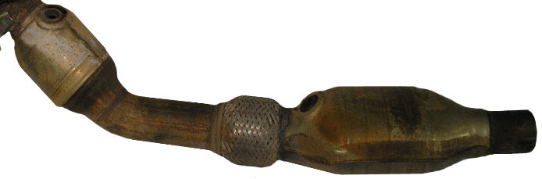
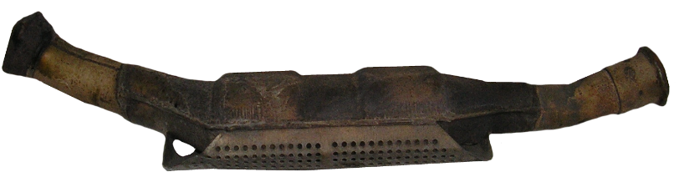
Importance of Platinum recovery for the EU economy
Source: Monolithos
Typical ores for PGMs contain 10 g PGM/ton ore
Typically 2 to 5g of platinum per catalyst unit ➔ concentration is more than 1000ppm (~100 times higher than natural ores)

Slide 9
Importance of PGM recovery for the EU economy
There is still an important gap between the amount of PGMs used for autocatalysts every year and the amount of PGMs recovered from autocatalysts.
In the last few years (2012-2016) the amount of platinum recovered globally from autocatalysts is slightly above 1Moz (28 tonnes) per year, while the amount of platinum demand/use globally in autocatalysts per year is often above 3Moz
If 100% of the platinum available in end-of-life autocatalysts were recovered per year, an additional 2Moz (~50 tonnes) of platinum would be available in the global market which is several times the global supply-demand gap.
Source : JM
Source : JM

Slide 10



Importance of PGM recovery for the EU economy
Europe has a very strong position in recycling and refining of PGMs already with major industrial players
Important to keep a lead time in innovation compared to the rest of the world
The Platirus project was designed to strengthen the European position in the production of PGMs

Slide 11













The Platirus project www.platirus.eu
PLATInum group metals Recovery Using Secondary raw materials
Aim: Reducing the European deficit of Platinum Group Metals (PGMs), by upscaling to industrial relevant levels a novel cost-efficient and miniaturised PGMs recovery and raw material production process
Targeted feedstocks: The targeted secondary raw materials will be autocatalysts, electronic waste (WEEE) and tailings and slags from nickel and copper smelters
Funding: The PLATIRUS project has received funding from the European Union's Horizon 2020 Research and Innovation program under Grant Agreement n° 730224
Duration: From 2016-11-01 to 2020-10-31
Platirus Consortium

Slide 12
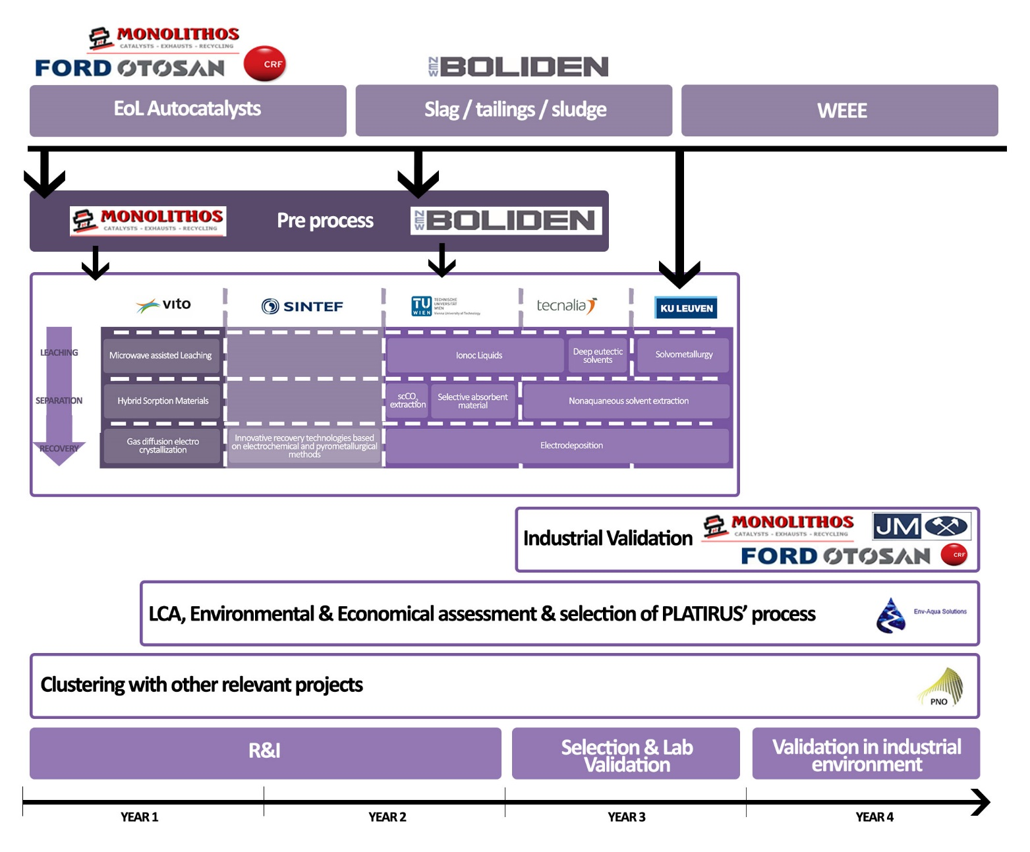
The Platirus project
Main Activities:
Upscaling to industrially relevant levels of a novel cost-efficient and miniaturised PGMs recovery and raw material production process,
Selecting the best (combination of) recovery technologies and developing a PLATIRUS recovery process and Blueprint Process Design for the final upscaling step, before market introduction.
Preparing and stimulating market introduction

Slide 13
The Platirus project benefits
Main benefits:
Fill the supply-demand gap of PGMs
Secure the supply of PGM materials and reduce dependency from global supply chains
Lower energy costs and environmental impacts
Providing solutions with low capital investment costs compared to centralized refineries to maximize the exploitation of the local wastes

Slide 14
Main contact
TECNALIA
Dr. Amal Siriwardana (Project Coordinator)
Amal.Siriwardana@tecnalia.com

